Slide 1
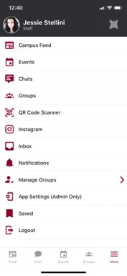
[EVENT NAME] CHECK IN
Step 1: Open or download the Crimson Connect App
Step 2: Click QR Code Scanner
Step 3: Scan this Code!
To find your event’s QR Code:
Log Into CrimsonConnect
Navigate to the event (either through your group page or the event list)
Click the name of the event
Click “Manage” at the top of the page
Click “Track Attendance”
Click the middle “Self Check-In QR Code” button
Screenshot the QR Code and link that populated
Paste that screenshot over this yellow box
Notes:
Drag bingo

